Slide 1
Systematic reviews, Meta-analysis in R – a practical guide
Clinical Epidemiology - Principles, Methods and Applications
Dr. Tobias Niedermaier
Division of Clinical Epidemiology and Aging Research
German Cancer Research Center (DKFZ)
Winter term 2022/23
February 14, 2023

Slide 2
Overview
Background
Systematic reviews
Key ideas of meta-analysis
Why naïve pooling is not reasonable
Forest plot
Important statistical issues in meta-analysis
Worked examples
Diagnostic test studies

Slide 3
Background – Systematic reviews
Systematic reviews (SRs) aim at retrieving and summarizing all relevant studies on a certain topic
Unlike narrative reviews, SRs have a clear search strategy in relevant data bases (PubMed, Web of Science, Embase, Scopus, Cochrane library, …)
SRs should have prespecified in- and exclusion criteria

Slide 4
Background – Meta-analysis
Meta-analyses are always based on systematic reviews but apply additional steps: results of individual studies are summarized in a quantitative way to come up with a single pooled estimate
Additional steps only done in meta-analyses: estimation of statistical heterogeneity, including meta-regression (not necessarily), assessment of publication bias, graphical presentation in the form of forest plots or similar plots. (Note: forest plots without summary estimate can also be done in systematic reviews, though it is less common)

Slide 5
Background
Advantages of systematic reviews and meta-analysis (SRMA) vs. narrative reviews:
  Reduce bias of the reviewer (adhering to prespecified protocols) and in the research studies (quality assessment)
  Higher precision (exhaustive search, potential inclusion of all relevant articles on the research topic)
Hierarchy of evidence: systematic reviews and meta-analyses are “on the top” compared to other study types

Slide 6
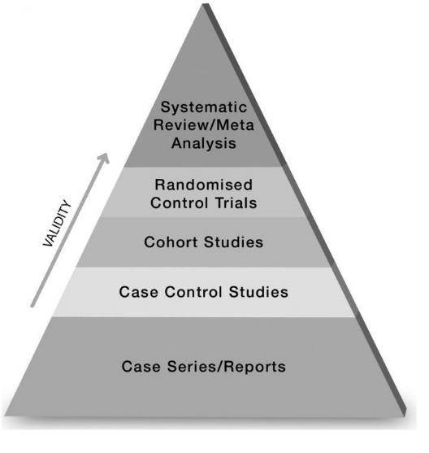
Background
Evidence hierarchy:
However: Meta-analyses of low-quality studies will still be considered low-quality evidence

Slide 7
Background
Steps in a systematic review (I):
Define research question
Optional, but recommended:
  Write a study protocol
  Register the protocol at PROSPERO (international register for systematic reviews). Why? →
    Avoid duplication of effort
    Avoid data-driven modification in eligibility criteria
    Avoid reporting bias and overstating of data-driven (rather than hypothesis-driven) findings
    Avoid publication bias in subsequent meta-analyses

Slide 8
Background
Steps in a systematic review (II):
Develop a search strategy
Define in- and exclusion criteria
Remove duplicate articles if several data bases are searched, then screen unique articles by title and abstract
Obtain and screen full texts of potentially relevant articles and decide whether to in- or exclude
Extract data from relevant studies by at least two researchers idenpendently
Assess study quality / risk of bias
Summarize results and write manuscript

Slide 9
Background
Protocols for systematic reviews
Statement paper: Moher D, Shamseer L, Clarke M, Ghersi D, Liberati A, Petticrew M, Shekelle P, Stewart LA. Preferred Reporting Items for Systematic Review and Meta-Analysis Protocols (PRISMA-P) 2015 statement. Syst Rev. 2015;4(1):1. doi: 10.1186/2046-4053-4-1
Explanation and Elaboration paper: Shamseer L, Moher D, Clarke M, Ghersi D, Liberati A, Petticrew M, Shekelle P, Stewart LA, the PRISMA-P Group. Preferred Reporting Items for Systematic Review and Meta-Analysis Protocols (PRISMA-P) 2015: elaboration and explanation. BMJ 2015.349:g7647. doi: 10.1136/bmj.g7647

Slide 10
Background
Reporting guidelines
PRISMA (Preferred Reporting Items for Systematic Reviews and Meta-Analyses)
PRISMA-P (PRISMA for review protocols)
MOOSE (Meta-analyses Of Observational Studies in Epidemiology)
STARD (Standards for Reporting Diagnostic accuracy studies)
Others, plus explanations etc.: https://www.equator-network.org/
STROBE – obervational studies
CARE – case reports
SRQR – qualitative research
CHEERS – economic evaluations
AGREE – clinical practice guidelines

Slide 11
First 14 of the 27 PRISMA checklist items

Slide 12
Remaining PRISMA checklist items
Section/topic | # | Checklist item | Reported on page #
Risk of bias across studies | 15 | Specify any assessment of risk of bias that may affect the cumulative evidence (e.g., publication bias, selective reporting within studies).
Additional analyses | 16 | Describe methods of additional analyses (e.g., sensitivity or subgroup analyses, meta-regression), if done, indicating which were pre-specified.
RESULTS
Study selection | 17 | Give numbers of studies screened, assessed for eligibility, and included in the review, with reasons for exclusions at each stage, ideally with a flow diagram.
Study characteristics | 18 | For each study, present characteristics for which data were extracted (e.g., study size, PICOS, follow-up period) and provide the citations.
Risk of bias within studies | 19 | Present data on risk of bias of each study and, if available, any outcome level assessment (see item 12).
Results of individual studies | 20 | For all outcomes considered (benefits or harms), present, for each study: (a) simple summary data for each intervention group (b) effect estimates and confidence intervals, ideally with a forest plot.
Synthesis of results | 21 | Present results of each meta-analysis done, including confidence intervals and measures of consistency.
Risk of bias across studies | 22 | Present results of any assessment of risk of bias across studies (see Item 15).
Additional analysis | 23 | Give results of additional analyses, if done (e.g., sensitivity or subgroup analyses, meta-regression [see Item 16]).
DISCUSSION
Summary of evidence | 24 | Summarize the main findings including the strength of evidence for each main outcome; consider their relevance to key groups (e.g., healthcare providers, users, and policy makers).
Limitations | 25 | Discuss limitations at study and outcome level (e.g., risk of bias), and at review-level (e.g., incomplete retrieval of identified research, reporting bias).
Conclusions | 26 | Provide a general interpretation of the results in the context of other evidence, and implications for future research.
FUNDING
Funding | 27 | Describe sources of funding for the systematic review and other support (e.g., supply of data); role of funders for the systematic review.

Slide 13
Background
Protocols for systematic reviews
Up to the results section of a manuscript, the PRISMA-P checklist items mimic those of the PRISMA checklist items but the focus is on what you are planning to do rather than what you did
Items regarding the Discussion are missing in PRISMA-P for obvious reasons
Checklist, statement, and explanation and elaboration available from http://www.prisma-statement.org/Extensions/Protocols.aspx

Slide 14
Search strategy – sources
Potential article sources:
- Systematic search:
PubMed, Web of Science, EMBASE, Scopus, Cochrane Library, PsycINFO, Europe PMC, (Google Scholar)
Cochrane Controlled Trials Register
- “Manual” search:
Cross-referencing (citing and cited articles)
Find articles from the same author/research group
Abstract books, conference proceedings etc.
Notes:
PsycINFO = database for literature in the field of psychology

Slide 15
Search strategy – search terms
Having appropriate search terms is the most crucial part of a systematic review, so some time should be spent on it in order to avoid repetetive searching due to previously inappropriate search terms
Advice: Check search terms of SRs published on similar topics in high-ranking journals
Try to do a preliminary search, sorted by relevance, obtain a few relevant articles from it, find further relevant articles via cross-referencing, check if preliminary search would have identified those relevant articles, refine if necessary
Have your search terms checked by your peers

Slide 16
Search strategy – example in PubMed and Web of Science
PubMed – example of the search for diagnostic accuracy studies using fecal immunochemical test:
(FIT[ti/ab] OR iFOBT[ti/ab] OR FOBT[ti/ab] OR stool[ti/ab] OR fecal[ti/ab] OR faecal[ti/ab] OR occult[ti/ab])
AND (CRC[ti/ab] OR colorect*[ti/ab] OR rectal[ti/ab] OR rectum[ti/ab] OR colon[ti/ab] OR colonic[ti/ab] OR bowel[ti/ab])
AND (carcinoma*[ti/ab] OR cancer[ti/ab] OR cancers[ti/ab] OR cancerous[ti/ab] OR neoplas*[ti/ab] OR adenocarcinoma*[ti/ab] OR tumor*[ti/ab] OR tumour*[ti/ab])
AND (sensitiv* OR accura* OR positiv* OR detect* OR miss* OR specifi*)
Stool test
Colorectal
cancer
Diagnostic
accuracy

Slide 17
Search strategy – example in PubMed and Web of Science
Web of Science:
TS=((FIT OR iFOBT OR FOBT OR stool OR fecal OR faecal OR occult)
AND (CRC OR colorect* OR rectal OR rectum OR colon OR colonic OR bowel)
AND (carcinoma* OR cancer OR cancers OR cancerous OR neoplas* OR adenocarcinoma* OR tumor* OR tumour*)
AND (sensitiv* OR accura* OR positiv* OR detect* OR miss* OR specifi*)

Slide 18
Search
Find terms that should appear in all relevant studies, combine them with “AND”
Find synonyms of terms and combine them with “OR”
Once you specified the search terms, organize your search:
  Remove duplicate articles
  Keep track of excluded studies and “stage” of exclusion (after screening title and/or abstract vs. after full-text screening)
  Keep track of reasons for excluding studies read in full-text
  Recommended: Use EndNote or Reference Manager

Slide 19
PRISMA Flow Diagram
Records identified through database searching
(n = )
Additional records identified through other sources
(n = )
Identification
Records after duplicates removed
(n = )
Screening
Records screened
(n = )
Records excluded
(n = )
Full-text articles assessed for eligibility
(n = )
Full-text articles excluded, with reasons
(n = )
Eligibility
Studies included in qualitative synthesis
(n = )
Included
Studies included in quantitative synthesis (meta-analysis)
(n = )

Slide 20
Key ideas of meta-analysis
Check if a meta-analysis actually makes sense. Counter examples might be:
  Too much heterogeneity (see later)
  Similarly: inconsistency regarding exposure and/or outcome definitions / lack of comparability
Extract effect sizes and measures of precision (variance) for each study

Slide 21
Why naïve pooling is not reasonable
Pooling can generate an effect where one
does not actually exist
(Bravata DM, Olkin I,
Simple pooling versus
combining in
meta-analysis,
Eval Health Prof (2001))

Slide 22
Why naïve pooling is not reasonable
Pooling can obscure effects that
do exist within the subgroups
Further reading:
Simpson’s paradox
(Bravata DM, Olkin I,
Simple pooling versus
combining in
meta-analysis,
Eval Health Prof (2001))

Slide 23
Why naïve pooling is not reasonable

Slide 24
Effect measures
Wide range of possible measures of effect size, e.g.:
  For binary data:
    RD (risk difference)
    RR (relative risk)
    OR (odds ratio)
  For continuous data:
    Mean difference
    Standardized mean difference
    Change in scores
  Time-to-event data:
    (log) HR (hazard ratio)

Slide 25
Important statistical issues in meta-analysis
Fixed-effect and random-effects models
Statistical heterogeneity
Publication bias

Slide 26
Fixed-effect models
FE models assume the presence of a common true effect among all studies and the observed estimates among each individual study

Slide 27
Fixed-effect models
Notes:
V(y) = within-study variance for study i

Slide 28
Fixed-effect models

Slide 29
Random-effects models

Slide 30
Random-effects models
“…we not only assume that effects of individual studies deviate from the true intervention effect of all studies due to sampling error, but that there is another source of variance introduced by the fact that the studies do not stem from one single population, but are drawn from a “universe” of populations.”
Doing Meta-Analysis in R
A Hands-on Guide
Mathias Harrer, M.Sc.
Prof. Dr. Pim Cuijpers
Prof. Dr. Toshi A. Furukawa
Assoc. Prof. Dr. David D. Ebert
The random-effects-model pays more attention to small studies when pooling the overall effect in a meta-analysis (Schwarzer, Carpenter, and Rücker 2015)
However, smaller studies are commonly thought to be more prone to bias
→Consider excluding very small studies
→Differences in summary estimates to be expected if many small studies are included and results of those studies differ from large studies
Notes:
The effect size might be larger or smaller depending on participants‘ characteristics (age, BMI, ethnicity) → assume that true effects are normally distributed

Slide 31
Random-effects models

Slide 32
Random-effects models

Slide 33
Random-effects models

Slide 34
Should I take a fixed or random-effects model?
Fixed-effects models are appropriate if we have strong reasons to believe that included studies are “functionally identical”. Example: Drug trials within the same country
Random-effects models are the right choice if we cannot be sure that all studies are “functionally identical/equivalent” (=in the majority of cases)
Exception: if very few studies → better to use fixed effects if possible, otherwise Bayesian approach

Slide 35
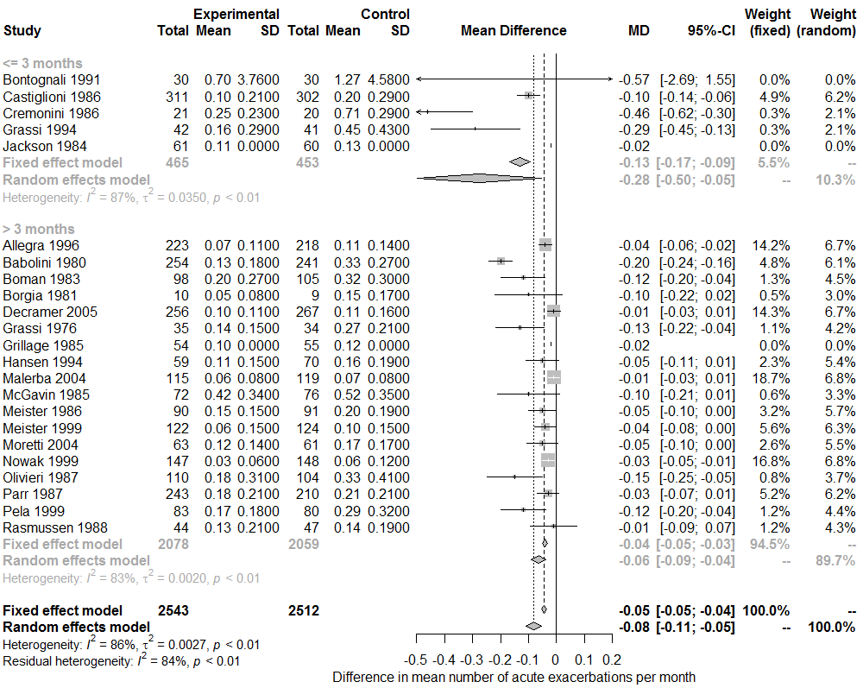
Forest plot

Slide 36
Heterogeneity
Present if there is more variation in the true effects of the underlying studies than expected by chance
May be caused by differences in study characteristics (participants, exposure, outcome)
Can be the result of bias in some studies (e.g. attrition, flawed design)
Options to explore heterogeneity:
  Subgroup analyses (only for discrete characteristics)
  Meta-regression (for discrete or continuous characteristics)
Notes:
Will come to options how to deal with heterogeneity later (4 slides after this one)

Slide 37
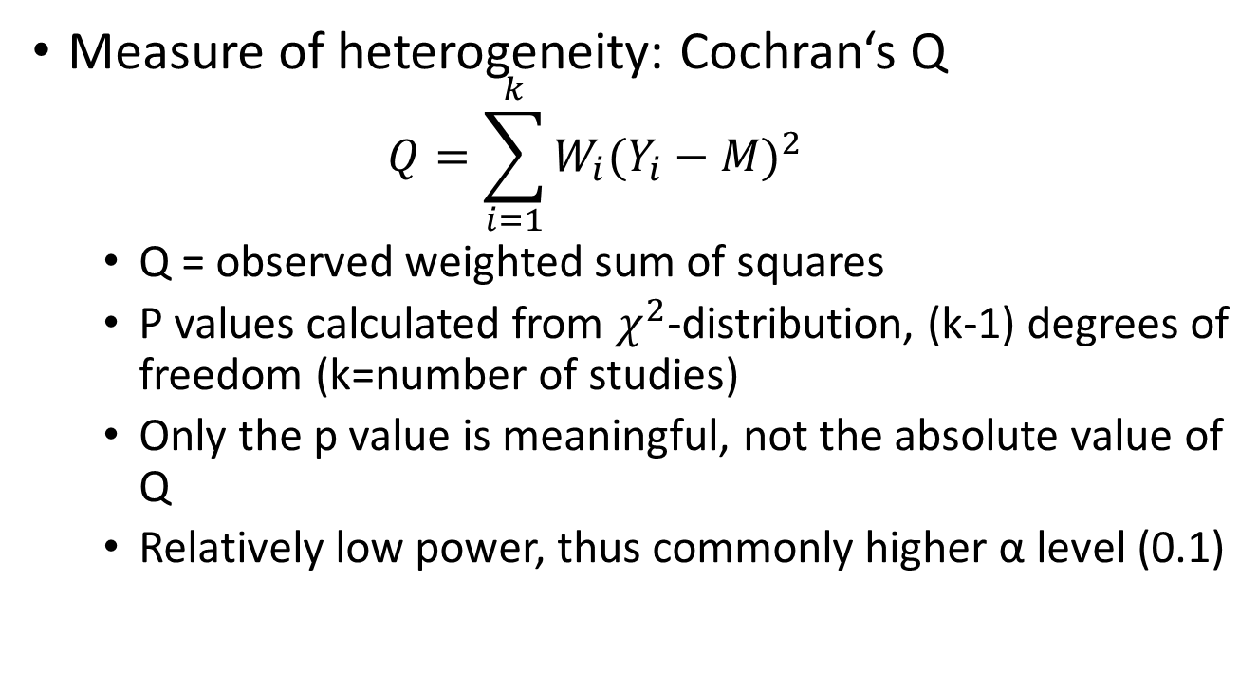
Heterogeneity
Measure of heterogeneity: Cochran‘s Q
  $$Q=\sum_{i=1}^{k}{W_{i}(Y_{i}−{M)}^{2}}$$
  Q = observed weighted sum of squares
  P values calculated from $χ^{2}$-distribution, (k-1) degrees of freedom (k=number of studies)
  Only the p value is meaningful, not the absolute value of Q
  Relatively low power, thus commonly higher α level (0.1)

Slide 38
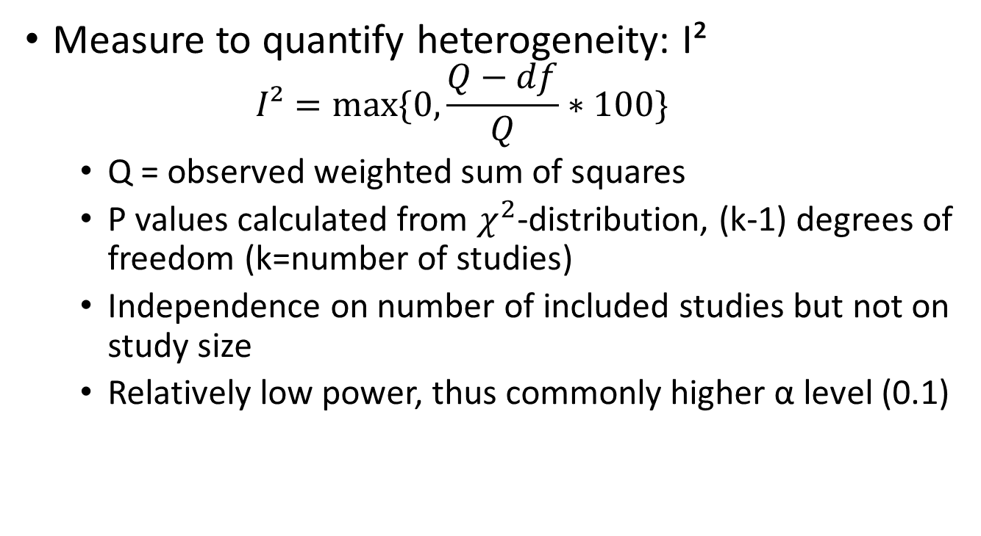
Heterogeneity
Measure to quantify heterogeneity: I²
  $$I²=max⁡\{0, \frac{Q−df}{Q}∗100\}$$
  Q = observed weighted sum of squares
  P values calculated from $χ^{2}$-distribution, (k-1) degrees of freedom (k=number of studies)
  Independence on number of included studies but not on study size
  Relatively low power, thus commonly higher α level (0.1)

Slide 39
Heterogeneity
Guidance on the interpretation of I2:
I2 = 0% : no heterogeneity
I2 = 25% : low heterogeneity
I2 = 50% : moderate heterogeneity
I2 = 75% : high heterogeneity
Higgins et al. (2003)

Slide 40
Heterogeneity
How to adress statistical heterogeneity?
Use a random-effects model which allows for heterogeneity
Stratify into more homogeneous subgroups if source of heterogeneity could be identified
Sometimes, a single outlier study contributes to significant heterogeneity → exclude one study at a time and compare results
Do not perform a meta-analysis but only a systematic or narrative review

Slide 41
Publication bias
If the probability of results being published depends on the “significance” of estimated effects, results of meta-analyses are biased
No definite way of telling if publication bias is present, but funnel plots provide helpful information
Variation in effect size expected to be larger in smaller studies, but over- and underestimated effect sizes should be equally frequent in the absence of publication bias (PB)
“Missing” small studies with null results suggest PB
(i.e., funnel plot asymmetry will be present)

Slide 42
Funnel plot
No publication bias
Publication bias present
Presence of bias due to low methodological quality
Testing for funnel plot asymmetry
Begg’s test and Egger’s test (the latter not recommended for binary outcomes)
Trim-and-fill method
  Trim small studies until an unbiased estimate of effect size symmetrically about the mean effect size
  Fill the original studies back and impute a mirror image for each (in order to correct the variance)
Notes:
I will come to trimm-and-fill later

Slide 43
Publication bias – example
Famous example: Tamiflu (Oseltamivir) from Roche
Medication is supposed to shorten and reduce symptoms associated with influenza
Studies were published that suggested associations between Tamiflu intake in influenza patients and shorter hospital stay
Authors of those studies were all paid by Roche
There own further studies which found no or very minor benefitial effects remained unpublished
Including all studies reveiled only very minor benefit of the medication and no evidence of reductions in serious complications

Slide 44
Study quality assessment
Study Quality Assessment Tools from the NIH: https://www.nhlbi.nih.gov/health-topics/study-quality-assessment-tools
McMaster University: https://www.healthevidence.org/documents/our-appraisal-tools/QA_Tool&Dictionary_10Nov16.pdf
Newcastle-Ottawa Scale (NOS) for assessing the quality of nonrandomised studies in meta-analyses: http://www.ohri.ca/programs/clinical_epidemiology/oxford.asp
QUADAS-2 for diagnostic accuracy studies: https://www.bristol.ac.uk/population-health-sciences/projects/quadas/quadas-2/

Slide 45
Example: Meta-analysis in R
Meta-analyses can be done in various statistical programs but we will focus on R (open source, free of charge, huge number of add-on packages)
https://cran.r-project.org/web/views/MetaAnalysis.html →overview of R packages related to meta-analysis
Widely used: ‘meta’ and ‘metafor’¹ for meta-analysis of RRs, ORs, RDs etc., HSROC or bivariate model (‘mada’) for diagnostic accuracy studies
¹(>9500 and >6900 citations according to Google Scholar and Web of Science, respectively)

Slide 46
Worked examples using the ‘meta’ package
Example for continuous outcome data:
Get dataset01.csv from https://www.uniklinik-freiburg.de/imbi/stud-le/meta-analysis-with-r.html
Select the appropriate model (fixed or random effects)
Select the appropriate function (here: metacont)
Understand the meaning of the relevant input parameters / “function arguments” (see next slide)
Select the appropriate outcome measure (e.g. mean difference)

Slide 47
meta package – function ‘metacont‘
Parameter | Function
Ne | The number of participants (N) in the intervention group
Me | The mean (M) of the intervention group
Se | The standard deviation (SD) of the intervention group
Nc | The number of participants (N) in the control group
Mc | The mean (M) of the control group
Sc | The standard deviation (SD) of the control group
data= | After ‘=’, paste the name of your dataset here
studlab=paste() | This tells the function were the labels for each study are stored. If you named the spreadsheet columns as advised, this should be studlab=paste(Author)
fixed= | Whether to use a fixed-effects-model
random | Whether to use a random-effects-model
prediction= | Whether to print a prediction interval for the effect of future studies based on present evidence
sm= | The summary measure we want to calculate. We can either calculate the mean difference (MD) or Hedges’ g (SMD)

Slide 48
meta package – function ‘metacont’
m <- metacont(Ne, Me, Se, Nc, Mc, Sc, studlab=paste(author, year), data=data)
forest(m, xlab="Maximum % fall in FEV1")
Subgroup analysis:
m <- metacont(Ne, Me, Se, Nc, Mc, Sc, studlab=paste(author, year), data=data, subgroup=stratvar, print.byvar=FALSE)
forest(m, xlab="Mean difference…")
Notes:
I will show an executable example soon.

Slide 49
meta package – meta-regression
Basic idea is similar to subgroup analysis but allows use of continuous predictors (compare also: stratification vs. multiple linear/logistic/Cox regression)
Each covariate should contain at least ten studies
Random effects model + meta-regression → mixed effects model
Rely on predefined scientific or theoretical questions
Avoid “playing around” until you find sth. significant
https://bookdown.org/MathiasHarrer/Doing_Meta_Analysis_in_R/metareg.html

Slide 50
meta package – meta-regression
require(meta) || (install.packages("meta") && require(meta))
data(Fleiss93cont)
# Add some (fictitious) grouping variables:
Fleiss93cont$age <- c(55, 65, 55, 65, 55)
Fleiss93cont$region <- c("Europe", "Europe", "Asia", "Asia", "Europe")
m1 <- metacont(n.e, mean.e, sd.e, n.c, mean.c, sd.c,
data = Fleiss93cont, sm = "MD")
mu2 <- update(m1, subgroup = region, tau.common = TRUE, fixed = FALSE)
metareg(mu2) ; bubble(metareg(mu2))
metareg(mu2, intercept=FALSE)
mu1 <- update(m1, byvar = region)
mu1; forest(mu1)
metareg(mu1, region + age)

Slide 51
Example outputs (plots) from the ‘meta’ package
#preparation:
data(Olkin95)
m1 <- metabin(event.e, n.e, event.c, n.c, data = Olkin95, subset = c(41, 47, 51, 59), studlab = paste(author, year), sm = "RR", method = "I")
Note:
event.e=Number of events in experimental group,
n.e=Number of observations in experimental group,
event.c=Number of events in control group,
n.c =Number of observations in control group
Notes:
Metabin: function for meta-analyses with binary outcomes. Subset: select only those 4 studies which are number 41, 47, 51, and 59 in the data set (row).

Slide 52
Example output (plot) from the ‘meta’ package
forest() and funnel() are customizable functions that are probably the most widely used ones for graphical outputs of meta-analyses
Basic funnel plot:
funnel(m1)

Slide 53
Worked examples using the ‘metafor’ package (I)
rm(list=ls(all=TRUE)) #clean up workspace
require(metafor) || (install.packages("metafor") && require(metafor))
#load package
data(dat.bcg) #load example data set with information on allocation and outcome (tpos=treatment, positive outcome, tneg=treatment, negative outcome, cpos=control, positive outcome, cneg=control, negative outcome)
str(dat.bcg) #take a look at the variables included in the data set
#ES <- escalc(measure="OR", ai=tpos, bi=tneg, ci=cpos, di=cneg, data=dat.bcg) #calculate effect measures (not needed here)
reml <- rma(method="REML", measure="OR", ai=tpos, bi=tneg, ci=cpos, di=cneg, data=dat.bcg) #meta-analysis, random-effects model
summary(reml)
Notes:
escalc is needed if, for example, for a particular study, yi and vi are known (i.e., have already been calculated) but the 2x2 table counts are not known; with replace=FALSE, the yi and vi values for that study are not replaced (from R help page)

Slide 54
Worked examples using the ‘metafor’ package (II)
#Meta-regression (mixed effects model):
meml <- rma(method="REML", measure="OR", ai=tpos, bi=tneg, ci=cpos, di=cneg, mods=dat.bcg$ablat, data=dat.bcg)
summary(meml) #notice the new part „, mods=dat.bcg$ablat“ which makes it a mixed effects model
Funnel plot, Egger's regression test & rank correlation test for funnel plot asymmetry:
funnel(reml) #Random−Effects Model; funnel(meml) #Mixed−Effects Model; regtest(reml) #Regression Test for Funnel Plot Asymmetry
Estimated influence of publication bias: trimfill(reml)
leave-one-out meta-analysis: leave1out(reml, trans=exp, digits=3)
Each study‘s influence on heterogeneity: baujat(reml)
normal QQ-Plots: qqnorm(reml, main="Q-Q normal plot")
Cumulative meta-analysis: forest(cumul(reml, order=order(dat.bcg$year)))

Slide 55
Worked examples using the ‘metafor’ package (III)
Forest plots:
forest(reml) #basic forest plot, log scale on x-axis
forest(reml, transf=exp, refline=1) #linear x-axis, i.e. non-symmetrical confidence intervals
forest(reml, addcred=T) #add 95% credibility region to summary estimate
forest(reml, order="prec") #order from most precise to least precise study
forest(cumul(reml, order=order(dat.bcg$year))) #cumulative meta-analysis, ordered by year (pooled estimates after adding new studies one by one)
forest(reml, slab=paste(dat.bcg$author, dat.bcg$year)) #add author names and publication year
forest(reml, slab=paste(dat.bcg$author, dat.bcg$year), showweights=TRUE) #show the weight of each study
#Subgroup analysis: see helpage of function forest.rma, section ### forest plot with subgrouping of studies

Slide 56
Example outputs from metafor
forest(reml, slab=paste(dat.bcg$author, dat.bcg$year), showweights=TRUE)

Slide 57
Example outputs from metafor
Cumulative meta-analysis:
forest(cumul(reml, order=order(dat.bcg$year)))

Slide 58
Example outputs from metafor
Normal, “classical”, funnel plot:
funnel(reml)

Slide 59
Trim-and-fill method
res <- rma(measure="RR", ai=tpos, bi=tneg, ci=cpos, di=cneg, data=dat.bcg, method="FE")
res.tf <- trimfill(res)
layout(matrix(c(1,2), ncol=2))
funnel(res)
funnel(res.tf, legend=TRUE, cex=1.2)
“The method can be used to estimate the number of studies missing from a meta-analysis due to the suppression of the most extreme results on one side of the funnel plot. The method then augments the observed data so that the funnel plot is more symmetric and recomputes the summary estimate based on the complete data. The trim and fill method can only be used in the context of a fixed- or random-effects model (i.e., in models without moderators). The method should not be regarded as a way of yielding a more "valid" estimate of the overall effect or outcome, but as a way of examining the sensitivity of the results to one particular selection mechanism (i.e., one particular form of publication bias).” (metafor help page on the function “trimfill”)

Slide 60
Trim-and-fill funnel plot:

Slide 61
Comparison of original and trim-and-fill funnel plot:
unpublished “mirror image” of a study

Slide 62
Further notes
plot(reml)
Creates a 4-in-1 plot comprising a forest plot, funnel plot, radial plot, and standardized residuals
Less versatile than individual functions regarding customizations, but gives a good first impression

Slide 63
Result of plot(reml):
Notes:
Radial plot: Standard error (x) vs. Standardized estimate (y).

Slide 64
Choice of the “method” used with rma.uni() in metafor
rma(measure="RR", ai=tpos, bi=tneg, ci=cpos, di=cneg, data=dat.bcg, method="FE") #fixed effects
…, method="DL") #DerSimonian-Laird estimator
"HE" = Hedges estimator
"HS" = Hunter-Schmidt estimator
"SJ" = Sidik-Jonkman estimator
"ML" = maximum-likelihood estimator
"REML" = restricted maximum-likelihood estimator
"EB" = empirical Bayes estimator
"PM" = Paule-Mandel estimator
"GENQ" = generalized Q-statistic estimator

Slide 65
Choice of the “method” used with rma.uni() in metafor
Details can be found in the help page (http://127.0.0.1:31466/library/metafor/html/rma.uni.html)
Results of the fixed-effects model can be quite different compared to the random-effects models
Reuslts of the various random-effects models are typically very similar
Restricted maximum likelihood estimator (REML) and DerSimonian-Laird (DL) are frequently used

Slide 66
Meta-analysis if only RR (or OR) and confidence intervals are known
library(meta)
data2 <- data.frame(matrix(nrow=13, ncol=0)) #columns will be added subsequently
data2$Study <- LETTERS[1:13] #just an example, better use real author names here
data2$rr <- c(0.1952, 0.1890, 0.2331, 0.2463, 0.2500, 0.3911, 0.3836, 0.6239, 0.7112, 0.8032, 0.9828, 1.0121, 1.5630)
data2$lcl <- c(0.0774, 0.0797, 0.1766, 0.1450, 0.0707, 0.1280, 0.3272, 0.3917, 0.5717, 0.5155, 0.5821, 0.8946, 0.3740)
data2$ucl <- c(0.4925, 0.4482, 0.3075, 0.4182, 0.8838, 1.1950, 0.4497, 0.9939, 0.8847, 1.2515, 1.6593, 1.1450, 6.5331)
#Compute the log(RR) and its standard error SElog(RR):
data2$log.rr <- log(data2$rr)
data2$se.log.rr <- (log(data2$ucl) - log(data2$lcl)) / (2*1.96)
#Meta-analysis using the metagen-function (generic meta-analysis):
ma2 <- metagen(TE = log.rr, seTE = se.log.rr, studlab = Study, data = data2, sm = "RR")
forest(ma2) #Forest plot
#See also: https://training.cochrane.org/handbook/current/chapter-06#section-6-3-1

Slide 67
Take-home messages
Follow best-practice when conducting systematic reviews (specify review question, in-/exclusion criteria, search strategy) and meta-analyses (select adequate model, consider heterogeneity, possible bias when pooling observational studies, publication bias)
Even a perfect analysis plan and adequate methods cannot compensate poor data/biased individual studies (“garbage in – garbage out”)
My advice: spend some time in finding an interesting and novel research question instead of replicating or updating existing meta-analyses

Slide 68
Thank you for your attention!
Acknowledgements:
PD Dr. Christian Stock and Dr. Katrin Jensen (IMBI Heidelberg) for many of the slides used here.
Contact:
Dr. Tobias Niedermaier
Division of Clinical Epidemiology and Aging Research
German Cancer Research Center (DKFZ)
Im Neuenheimer Feld 581
69120 Heidelberg
Tel: +49 (0)6221 42 1312
Email: t.niedermaier@dkfz-heidelberg.de

Slide 69
Useful R packages for meta-analysis
meta
metafor
rmeta
forestplot
mada
Check CRAN Task View: Meta-Analysis for packages more specific to a certain type of meta-analysis (uni- or multivariate, network, individual participant data) or specific tasks (graphics, small study bias, meta-regression, simulation etc.)

Slide 70
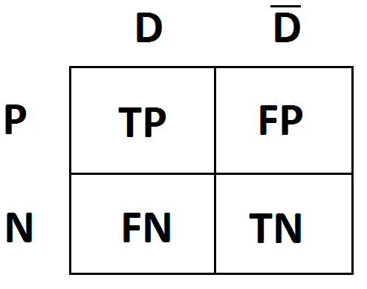
Add-on: Diagnostic test studies
Diagnostic tests aim at classifying individuals correctly into those with the target condition (who should be test-positive) and those without the target condition (who should be test-negative)
D=disease present
“D dash”=disease absent
P=test positive
N=test negative
TP=true positive, FP=false p.
TN=true neg., FN=false neg.

Slide 71
Diagnostic test studies
Sensitivity: TP/(TP+FN)
Specificity: TN/(TN+FP)
Positive predictive value: TP/(TP+FP)
Negative predictive value: TN/(TN+FN)
Diagnostic odds ratio: (TP/FN)/(FP/TN)
Sensitivity and specificity are typically negatively correlated and dependent on the marker cutoff
Separate pooling of both measures is not appropriate, requiring more sophisticated models

Slide 72
Diagnostic test studies
Historically: diagnostic odds ratios were pooled like normal odds ratios (fixed or random effects model)
Popular up-to-date models: HSROC and bivariate model
Those two models are mathematically equivalent in the absence of covariates (Harbord et al. 2006)
Requirements:
  Reasonable number of studies (5 parameters estimated)
  Numbers of TP, FN, FP, TN available for each study
  No cells of any study containing 0 (else: continuity corr.)

Slide 73
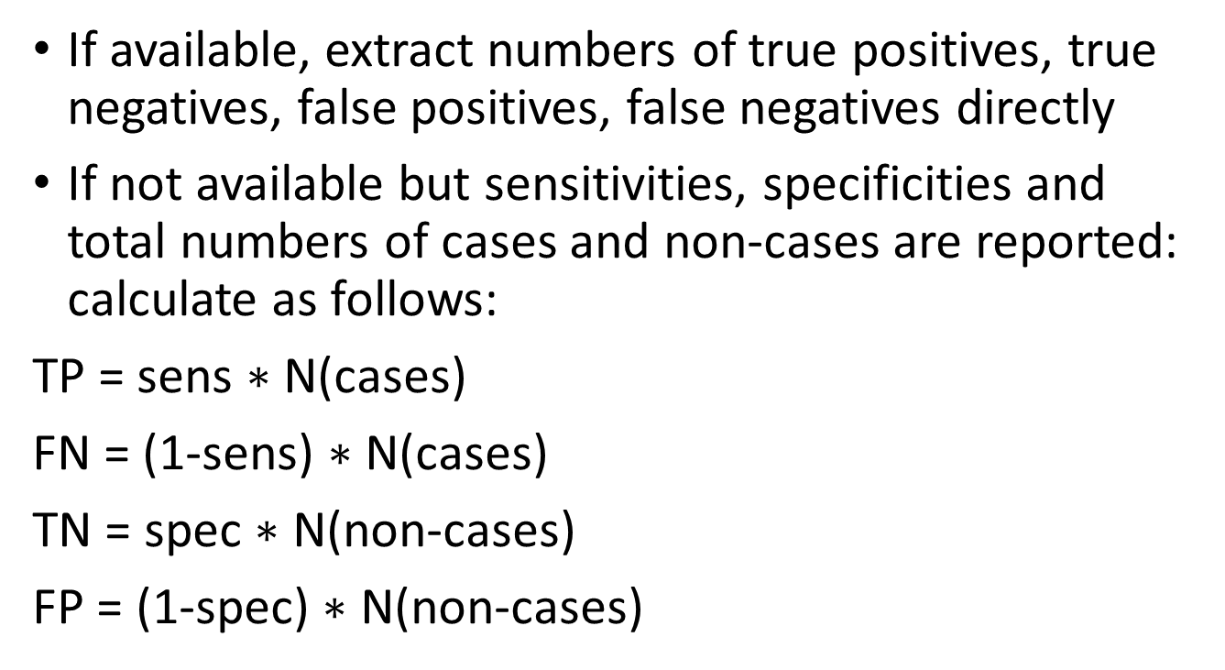
Dataset preparation (I)
If available, extract numbers of true positives, true negatives, false positives, false negatives directly
If not available but sensitivities, specificities and total numbers of cases and non-cases are reported: calculate as follows:
TP = sens $∗$ N(cases)
FN = (1-sens) $∗$ N(cases)
TN = spec $∗$ N(non-cases)
FP = (1-spec) $∗$ N(non-cases)

Slide 74
First 13 of the 30 STARD checklist items

Slide 75
Remaining STARD checklist items

Slide 76
Dataset preparation (II)
Create an excel sheet which looks approximately like this:
First author | Year | TP | FN | FP | TN | strat_var
Smith | 2010 | 204 | 15 | 163 | 2016 | 1
Johnson | 2012 | 134 | 6 | 194 | 1432 | 1
Williams | 2013 | 86 | 20 | 12 | 157 | 1
Brown | 2015 | 353 | 40 | 126 | 1643 | 0
Jones | 2015 | 117 | 27 | 56 | 736 | 0
Miller | 2017 | 166 | 14 | 120 | 961 | 1
Davis | 2018 | 50 | 7 | 34 | 390 | 0

Slide 77
Analysis in R (I)
Read in the data set in R:
    setwd("X:\\Path\\to\\file")
    dat <- read.csv2("data_extraction_sheet.xlsx", header=TRUE, stringsAsFactors=FALSE)
Make sure the relevant variables are recognized as numeric:
  dat[,("TP", "FN", "FP", "TN")] <- as.numeric(as.character(dat[,("TP", "FN", "FP", "TN")]))
  If necessary, select relevant subset:
    dat_sub1 <- dat[dat$strat_var==1,]
  Load R package "mada": library(mada)

Slide 78
Analysis in R (II)
  Show descriptive data and double-check with original publication:
    (x <- madad(dat, correction=0, method="clopper-pearson"))
    crosshair(dat, correction=0, method="clopper-pearson")
    ROCellipse(x, correction=0, method="clopper-pearson")
    forest(x, type="sens")
    forest(x, type="spec")
  More information on different CIs of proportions:
  https://towardsdatascience.com/five-confidence-intervals-for-proportions-that-you-should-know-about-7ff5484c024f
Notes:
Note: „correction“>0 applies a continuity correction to all cells of all studies (unless „correction.control=„single“, then only to studies with at least 1 cell=0)
method=method to calculate confidence intervals for sensitivities and specificities (alternatives: wald, wilson, agresti-coull, jeffreys, modifiedwilson etc.)

Slide 79
Analysis in R (III)
  Perform meta-analysis:
reitsma_model <- reitsma(dat)
plot(reitsma_model, main="SROC curve, summary estimate and confidence\nregion of the bivariate Reitsma model")
points(fpr(dat), sens(dat), pch=2, cex=0.5)
legend("bottomright", c("data", "summary estimate"), pch = c(2,1))
legend("bottomleft", c("SROC", "conf. region"), lwd = c(2,1))
summary(reitsma_model)

Slide 80
Analysis in R (IV) - Result of summary(reitsma_model):

Slide 81
Analysis in R (V) – Explanation of the output
Row “sensitivity”, column “Estimate”: Point estimate for pooled sensitivity
Row “sensitivity”, column “95%ci.lb”: lower bound of 95% confidence interval for pooled sensitivity
Row “sensitivity”, column “95%ci.ub”: upper bound of 95% confidence interval for pooled sensitivity
Row “false pos. rate”: equals 1-specificity
Variance components: typically not necessary
AUC: overall accuracy when pooling all studies
pAUC: same but restricted to 100-80% specificity
HSROC parameters: typically not interesting

Slide 82
R packages suitable for meta-analysis of diagnostic tests
mada (bivariate Reitsma model incl. meta-regression, Journal of Clinical Epidemiology, 58, 982–990)
Metatron (bivariate Reitsma model)
Metamisc (Riley model, Biostatistics 2008; 9: 172–186)
bamdit (Bayesian bivariate model, Statistics in Medicine. 29(30):3088-102)
meta4diag (Bayesian bivariate model, Statistics in Medicine 36(19): 3039–3058)
CopulaREMADA (Copula Mixed Models, doi:10.1002/sim.6595)
diagmeta (doi:10.1186/s12874-016-0196-1)
HSROC (HSROC, Statistics in Medicine, 20, 2865–2884)
CopulaDTA (Copula Based Bivariate Beta-Binomial Model, oi:10.18637/jss.v082.c01)

Slide 83
Worked examples for selected packages (I)
#1.) mada
library(mada)
data(Dementia)
Dementia
summary(reitsma(Dementia))[1]
summary(reitsma(Dementia, correction.control="single", correct=0.0001))[1]
#Plotting:
crosshair(Dementia)
ROCellipse(Dementia, pch=".", cex=3)
reitsma_model <- reitsma(Dementia, correction.control="single", correct=0.0001)
plot(reitsma_model, main="SROC curve, summary estimate and confidence\nregion of the bivariate Reitsma model")
points(fpr(Dementia), sens(Dementia), pch=2, cex=0.5)
legend("bottomright", c("data", "summary estimate"), pch = c(2,1))
legend("bottomleft", c("SROC", "conf. region"), lwd = c(2,1))
forest(madad(Dementia, correction.control="single", correction=0.0001), type="sens", snames=c(LETTERS[1:26], letters[1:7]), main="Sensitivity")
forest(madad(Dementia, correction.control="single", correction=0.0001), type="spec", snames=c(LETTERS[1:26], letters[1:7]), main="Specificity")

Slide 84
Example output ‚mada‘ package (I)

Slide 85
Example output ‚mada‘ package (II)

Slide 86
Example output ‚mada‘ package (III)

Slide 87
Example output ‚mada‘ package (IV)

Slide 88
Worked examples for selected packages (II)
#2.) Metatron
library(Metatron)
Dementia$study_id <- c(LETTERS, letters[1:7])
x <- fit.bivar(TP=TP, FN=FN, TN=TN, FP=FP, study=study_id, data=Dementia)
summary(x)
#coefficient logit sensitivity: e.g. 1.427642
#coef. logit specificity: e.g. 2.198466
#https://stat.ethz.ch/R-manual/R-devel/library/boot/html/inv.logit.html
#The inverse logit is defined by exp(x)/(1+exp(x))
#https://www.ncbi.nlm.nih.gov/books/NBK115744/
→sens: 80.7%, spec: 90.0%. 95%-CIs: -/+ 1.96* std. error

Slide 89
Worked examples for selected packages (III)
#3.) metamisc
library(metamisc)
summary(riley(Dementia))
plot(riley(Dementia, slab=c(LETTERS[1:26], letters[1:7]))) #forest plots
#funnel plot asymmetry test:
(fat_Dementia <- fat(log(mada::madad(Dementia)$DOR$DOR), madad(Dementia)$DOR$se.lnDOR)) Default: "E-FIV" (Egger's test with multiplicative dispersion)
plot(fat_Dementia)
plot(fat_Dementia, confint = TRUE, confint.level = 0.1, confint.col = "lightgrey", confint.density = NULL, xlab = "Effect size (log DOR)")

Slide 90
Plot of log(diagnostic odds ratio) vs. standard error (publication bias assessment)

Slide 91
Example output ‚metamisc‘ package
plot(riley())

Slide 92
Worked examples for selected packages (IV)
#4.) bamdit
library(bamdit)
res <- metadiag(Dementia, two.by.two=TRUE, re.model="SeSp")
summary(res)
plot(res)
res[]

Slide 93
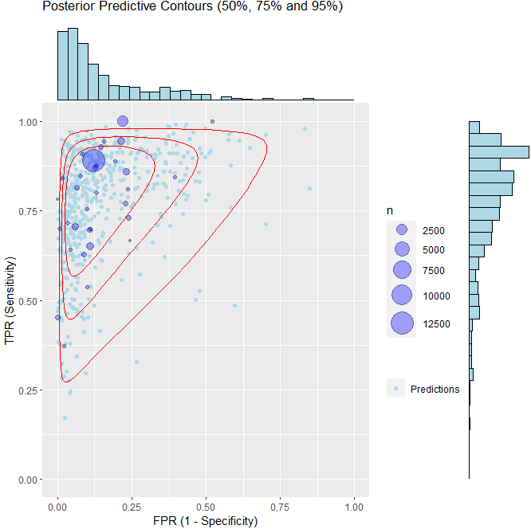
Example output ‚bamdit‘ package
plot(metadiag(Dementia, two.by.two=TRUE, re.model="SeSp"))

Slide 94
Worked examples for selected packages (V)
#5.) meta4diag
library(meta4diag)
#install.packages("INLA", repos=c(getOption("repos"), INLA="https://inla.r-inla-download.org/R/stable"), dep=TRUE)
library(INLA)
res <- meta4diag(data=Dementia)
summary(res)
outdata = makeData(data=Dementia, model.type=1)
outpriors = makePriors(var.prior = "invgamma", cor.prior = "normal",
var.par = c(0.25, 0.025), cor.par = c(0, 5))
model <- runModel(outdata, outpriors, link = "logit",
quantiles = c(0.025, 0.5, 0.975), verbose = FALSE)

Slide 95
Example output ‚meat4diag‘ package
crosshair(res)

Slide 96
Example output ‚meat4diag‘ package
forest(res, accuracy.type="sens")
forest(res, accuracy.type="spec")

Slide 97
Example output ‚meat4diag‘ package
#ROC-Plotting function:
SROC(res)

Slide 98
Worked examples for selected packages (VI)
#6.) diagmeta (considers multiple cutoffs)
library(diagmeta)
data(Schneider)
data(Schneider2017)
diag1 <- diagmeta(tpos, fpos, tneg, fneg, cutpoint,
studlab = paste(author, year, group), data = Schneider2017, model = "DIDS", log.cutoff = TRUE)
summary(diag1)
plot(diag1)
summary(diag1)
diagstats(diag1)

Slide 99
Example output ‚diagmeta‘ package

Slide 100
References and further reading
https://www.ncbi.nlm.nih.gov/pmc/articles/PMC3024725/
https://bookdown.org/MathiasHarrer/Doing_Meta_Analysis_in_R/
http://www.metafor-project.org/doku.php
https://cran.r-project.org/web/packages/mada/vignettes/mada.pdf
CRAN Task View: Meta-Analysis (http://cran.r-project.org/web/views/MetaAnalysis.html)
Meta-analysis of diagnostic accuracy studies in Stata:
doi 10.1007/978-1-0716-1566-9_11
And in SAS: google „MetaDAS: A SAS macro for meta-analysis of diagnostic accuracy studies”

Slide 101
References and further reading
Schwarzer, Guido, Carpenter, James R., Rücker, Gerta. Meta-Analysis with R, Springer (Use R! series)
Bravata DM, Olkin I, Simple pooling versus combining in meta-analysis, Eval Health Prof (2001)
Borenstein, M., Hedges, L. V., Higgins, J. P., and Rothstein, H. R. (2009). Introduction to Meta-Analysis. Wiley.
Chen, D.-G. and Peace, K. E. (2013). Applied Meta-Analysis with R. Chapman & Hall/CRC Biostatistics Series
Cochrane Collaboration (2020). Cochrane Handbook for Systematic Reviews of Interventions. Version 6.1. Wiley. URL: https://training.cochrane.org/handbook/current
Egger, M., Davey-Smith, G., and Altman, D. G. (2000). Practical Meta-Analysis. Wiley.
Welton, N. J., Sutton, A. J., Cooper, N. J., Abrams, K. R., and Ades, A. E. (2012). Evidence Synthesis for Decision Making in Healthcare. Statistics in Practice. Wiley

Slide 102
References and further reading
Duval, S. and Tweedie, R. (2000). Trim and fill: A simple funnel-plot-based method of testing and adjusting for publication bias in meta-analysis. Biometrics, 56(2):455–463.
DerSimonian, R. and Laird, N. (1986). Meta-analysis in clinical trials. Control Clin Trials, 7(3):177–188.
Egger, M., Davey Smith, G., Schneider, M., and Minder, C. (1997). Bias in meta-analysis detected by a simple, graphical test. BMJ, 315(7109):629–634.
Higgins, J. P., Thompson, S. G., Deeks, J. J., and Altman, D. G. (2003). Measuring inconsistency in meta-analyses. BMJ, 327(7414):557–560.
https://www.meta-analysis-workshops.com/download/bookChapterSample.pdf
Leeflang, M.M.G. (2014). Systematic reviews and meta-analyses of diagnostic test accuracy. Clin Microbiol Infect 2019 Nov;25(11):1315-1327
Doebler P. (2020). Meta-Analysis of Diagnostic Accuracy with mada (R package vignette)

